Slide 1
FPS' Virtual Open House!

Slide 2
Virtual Opern house!
*Ms. Clark
*Mrs. Colbert
*Mrs. Garrett
*Mrs. Prescott
Meet Your Teachers....

Slide 3
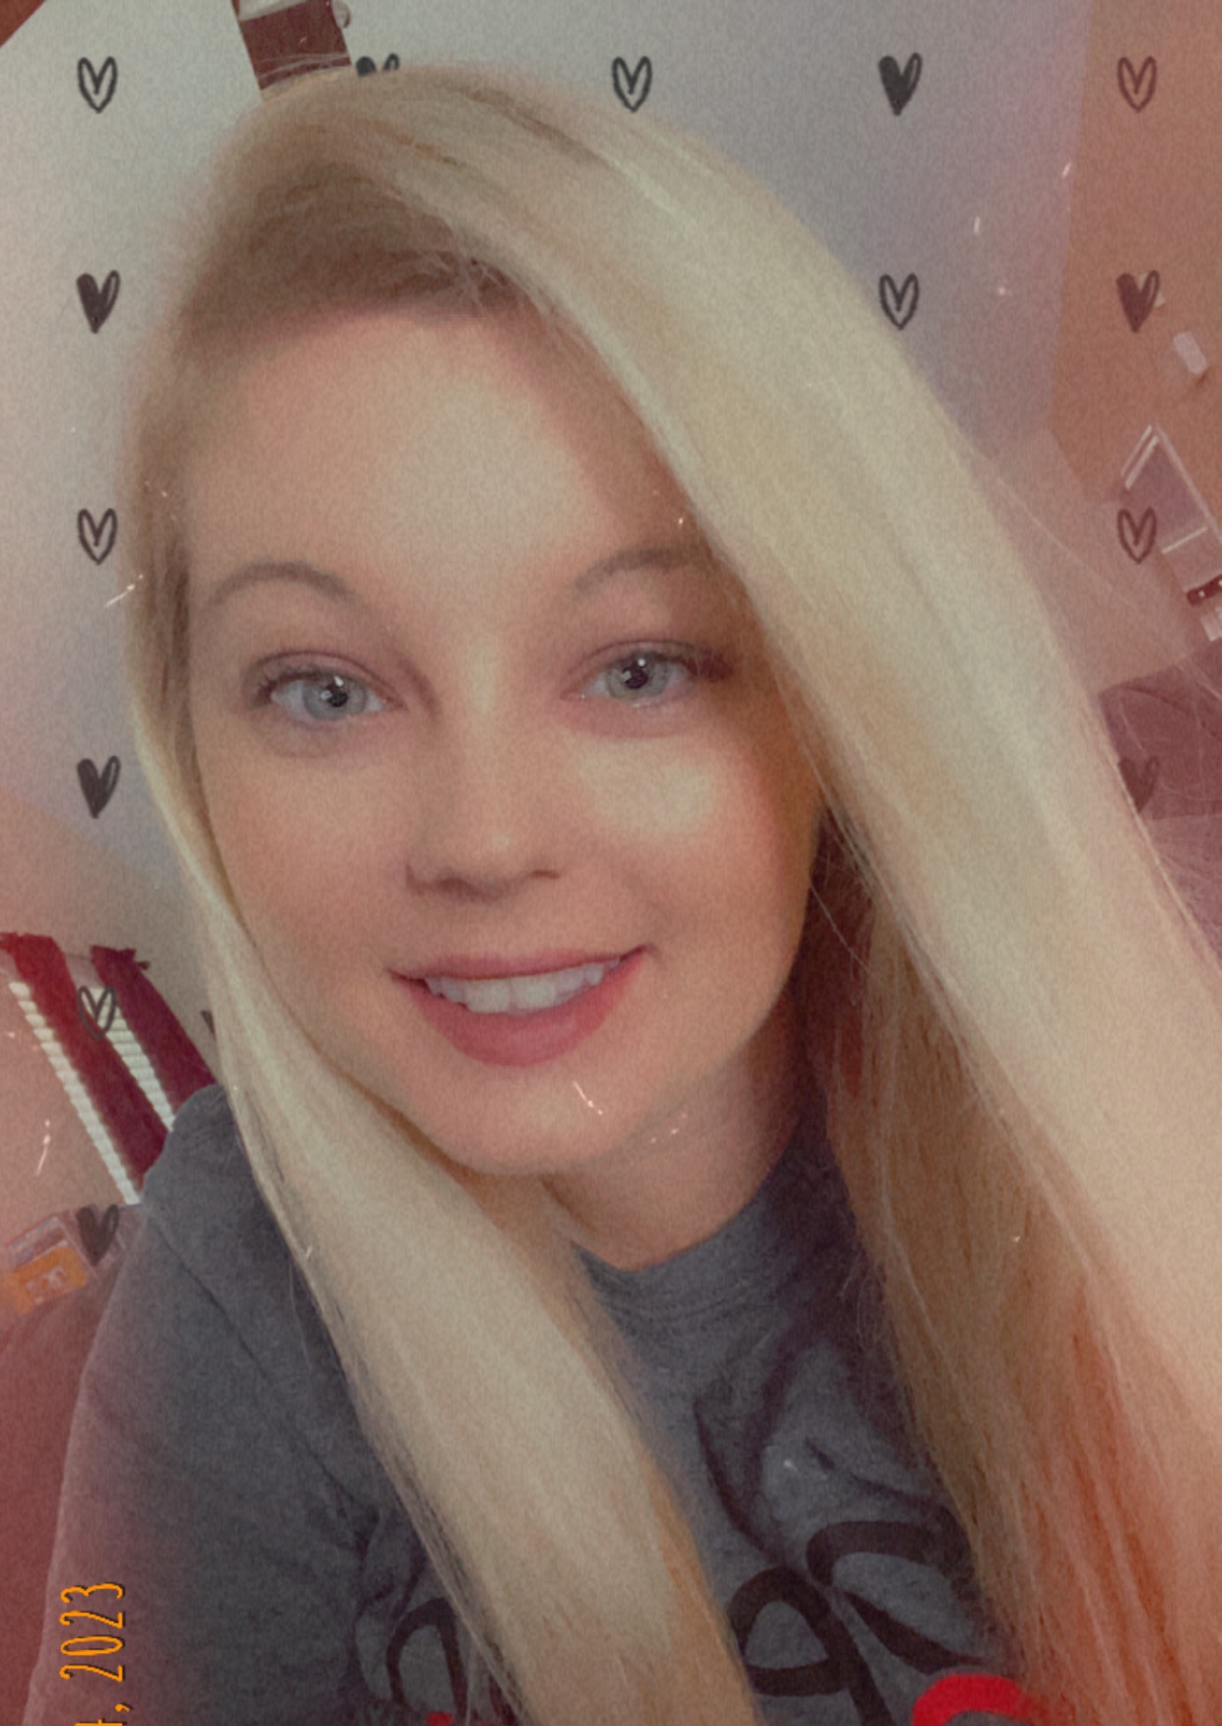
Ms. Clark
•I was born in Gallipolis, Ohio. Where I grew up and went to college. I got married and the military moved us to Virginia for 3 years, then Georgia.
•I have lived in Ohio, West Virginia, Virginia, and now Georgia.
•This will be my third year of teaching. In those years I have taught 1st grade. This will be my first year teaching second grade.
•I love Dunkin' Donuts, my dog Cali, and spending time with my nieces.

Slide 4
Mrs. Colbert
* Room 306
* 16 years of teaching!
* Raised in the Army!
* Green is my favorite color!
* I love spending time with my family and writing.

Slide 5
Mrs. Garrett
* This is my 11th year teaching and 6th year at Freedom Park School.
I am married to David & a toddler mom!
I have a Bachelor's and Master's Degree in Elementary Education from Augusta University.
I love teaching 2nd grade!
My family and I enjoy going to Edisto, SC every summer to go to the beach!

Slide 6
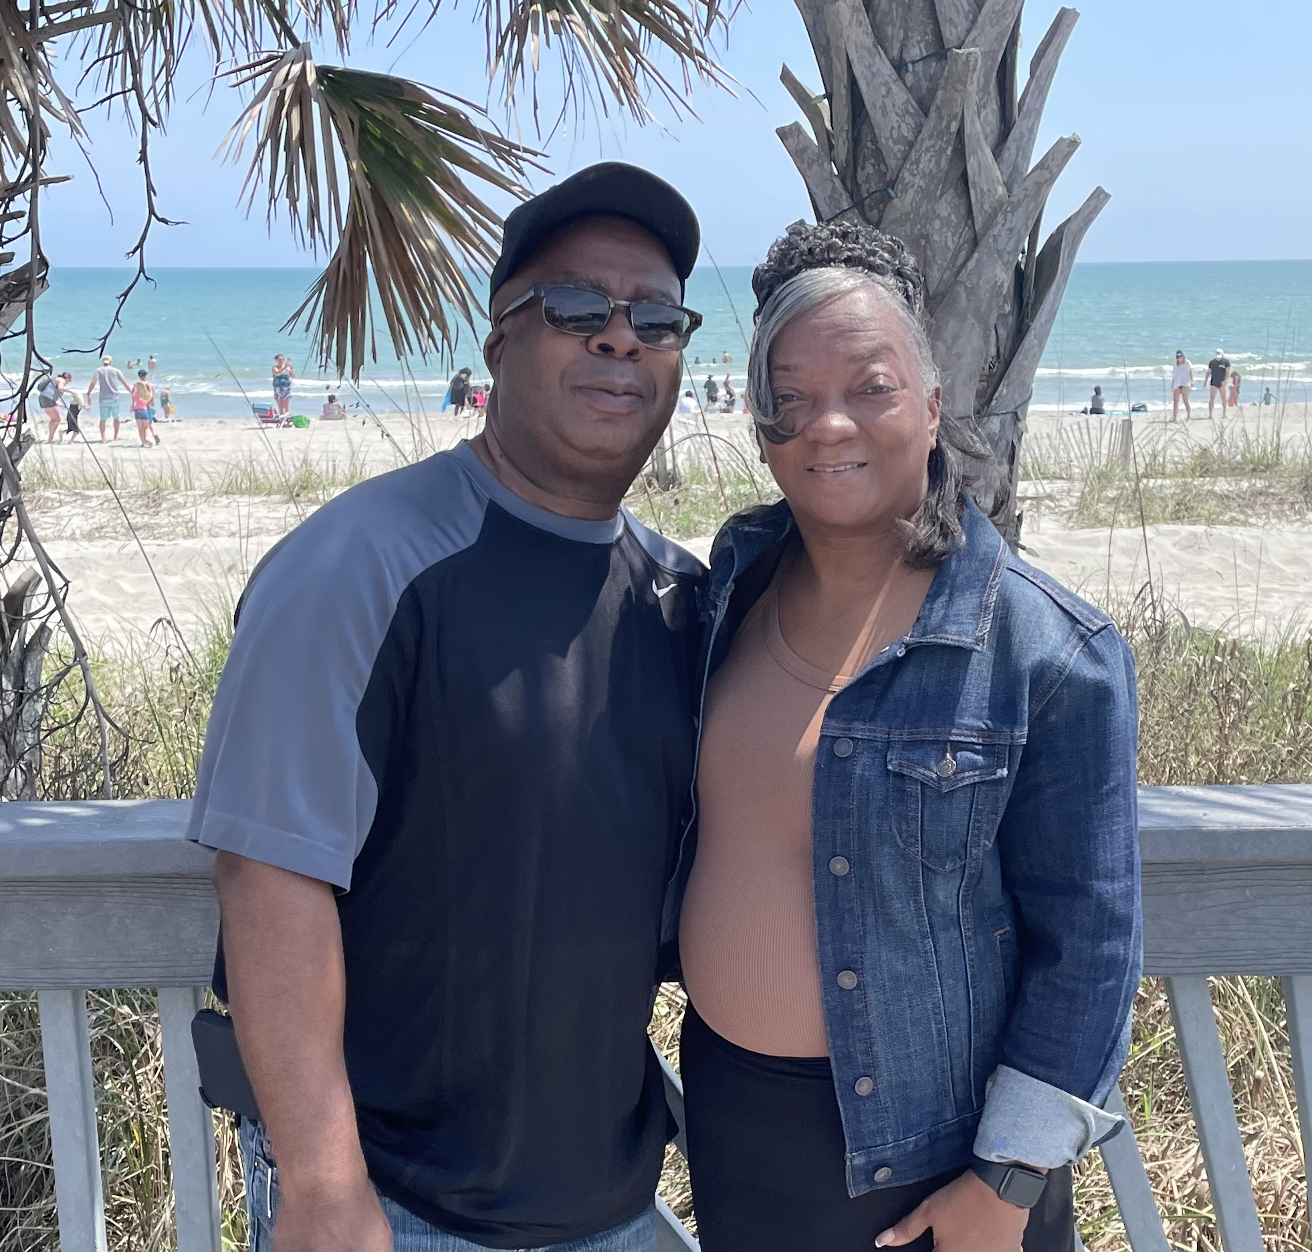
Mrs. Prescott
*I am currently working on my Ed. D Degree
*Highly qualified (General & Special Education)
*Reading, Math, Gifted, Dyslexia Endorsements
*This is my 18th year as an Educator!

Slide 7
2nd GRADE SYLLABUS
2nd Grade Syllabus

Slide 8
What will students learn?
* Phonics
* Reading Comprehension
* Main Idea
* Author's Purpose
* Grammar & Conventions
~ capitalization
~ punctuation
~ spelling
* Text Features
Writing
* Narrative
* Information
* Opinion
*Matter
*Force & Motion
*Sun, Moon, & Stars
*Life Cycles
* Addition / Subtraction
* Place Value
* Time
* Money
* Measurement
* Data
* Geometry
* Multiplication
* Historical Figures
* Economy
* Government
* Cherokee & Creek

Slide 9
2nd Grade Supply List
2nd Grade Supply List

Slide 10
Daily schedule for 2nd grade (Tentative)
7:30 – 7:45 | Announcements, morning work, & attendance
7:45 – 8:30 8:30 - 8:40 | Intervention SEL
8:40 – 9:10 (30 min) | Fundations (Phonics)
9:10 – 10:20 (70 mins) | Reading/Writing Workshop/Small Groups
10:20- 10:40 | Social Studies/Science
10:47- 11:18 | LUNCH
11:18- 11:40 | Recess
11:40- 12:20 | Specials (PE, Computer, Art, Spanish)
12:20- 1:20 (60 min) | Math Workshop- Eagle 5/Number Talks/Lesson
1:20- 1:50 (30 min) | Math Workshop (Small Groups)
2:20- 2:30 | Dismissal
The content in this schedule is tentative and subject to change.

Slide 11
How do students go home? *Car Riders *Parent Pick-Up (Large Gym) *Bus Riders *Walkers *.
*Car Riders*
*Your child will receive a number and will be called to come out to the car line. (Please contact your child's teacher if you do not know your child's number.)
*Please make sure you know your child's car line number and place the number on your windshield.
*Students will come out as swiftly as they can.

Slide 12
Communication
Best ways to communicate with your teacher:
1.) Classroom Dojo App (Please download the app on your phone). Your teacher will send messages, as well as put information on Class Story with updates.
*Each teacher will help you get set up with Classroom Dojo*
2.) Email (See next slide for your teacher's email).
3.) If you need to see us face to face, let us know!

Slide 13
Communication Continued... Email: Ms. Clark's Email: clarkme1@boe.richmond.k12.ga.us Mrs. Colbert's Email: Colbeki@boe.richmond.k12.ga.us Mrs. Garrett's Email: GarreLo@BOE.Richmond.k12.ga.us Mrs. Prescott's Email: *Mrs. Prescott is currently waiting on her email to be set up in the system.

Slide 14
Digital Resources es
LaunchPad
SeeSaw
I-Ready
Microsoft Office
Math
Social Studies
Science
Class Dojo
PT Communication
Online Library

Slide 18
Freedom Park School
Principal - Dr. Titania Singh
Assistant Principal – Ms. Amanda Darville
Assistant Principal – Ms. Wendy May

Slide 19
School Hours
Breakfast – 6:50 am
Instruction Begins – 7:25 am
Dismissal – 2:15 pm

Slide 20
Attendance Policy
Students are expected to be in school all day unless they are ill. Georgia State law only recognizes absences due to illness, religious holidays, medical or legal appointments, and funerals in the family. Parents have the right to present reasons they believe are justifiable to the Principal for consideration of other absences.
All absences require a written note from parents/guardians stating the reason for the absence. Emailed notes will not be accepted. A note without a reason and date of absence is unexcused. The note must include the student's full name, reason for absence, date(s) of absence, and parent/guardian signature.
In order to comply with district regulations and state law, when a student has 10 unexcused absences in one month or ten unexcused absences in one year, Richmond County administrators will petition the Juvenile Court System to seek mandatory attendance by a student. An unexcused absence is defined as any unauthorized absence from school. Examples include, but are not limited to:
1. Hair appointments
2. Oversleeping
3. Shopping
4. Missing the bus
5. Concerts
6. Babysitting
7. Failure to obtain private transportation to school
8. Mechanical problem
9. Failure to obtain leave of Absence request for absences

Slide 21
Tardy Policy
Students are not allowed on campus prior to 6:50 a.m. Any student reporting to the classroom after 7:25 a.m. is tardy. A parent must sign in tardy students.
The accumulation of unexcused tardies may warrant disciplinary action and/or referral to
Department of Family and Children Services.
Leaving school for unauthorized purposes before the end of the instructional day will be counted as
a tardy. Parents should not pick their children up before the end of the school day except where
there is a legitimate emergency. Lawful excuses for tardiness are cited in the RCSS Code of Student
Conduct and Discipline.
For the safety of our students during dismissal transition, we will not allow building entry starting at 1:55 pm until 2:10pm.

Slide 22
Title I
Title I
Freedom Park School is a Title I school. This means we are provided financial assistance through the Every Student Succeeds Act, Part A. Its overall purpose is to ensure that all students have a fair and equal opportunity to obtain a high-quality education and reach, at a minimum, proficiency on state assessments (i.e. GA Milestones, End-of-Course, etc.), as well as involve parents in their child's education.
There will be an upcoming Title I Annual Parent Meeting which will outline parent involvement opportunities - you will be sent meeting information via FPS's ClassDojo account later in the school year.
If you have any questions, please contact the FPS Title I Parent Facilitator:

Slide 23
Bullying: No Bullying. It’s the Law.
Bullying behavior is defined as any pattern of written or verbal expression or any physical act or gesture that is intended to ridicule, humiliate, intimidate, or cause measurable physical or emotional distress upon one or more students:
A student shall not do, attempt, or threaten to bully any person, including students and employees:
a) In the school
b) On school grounds
c) In school vehicles (including school buses)
d) At school bus stops
e) Or at school activities or sanctioned events
A third instance of bullying in a school year would require that the student be assigned to an alternative educational setting. However, the principal or other appropriate designee may recommend the Alternative Center or suspension, in her discretion prior to the third offense.
*FOR PRE-K – 5 REFER TO RULES 23 AND 24 (RCBOE CODE OF CONDUCT)
*FOR 6 -12 DISCIPLINE OPTIONS, REFER TO RULES 23, 24, &amp;27 (RCBOE CODE OF CONDUCT)
Code of Discipline for Freedom Park School
Students are expected to display admirable Character Traits at all times. They are representative of their family, school and community. At FPS we have always maintained a respectful environment for staff and students.

Slide 24
Breakfast starts and 6:50 am and is free for all students. Breakfast ends at 7:20 am
Lunch is not free for every student. Please apply for our free or reduced lunch plan.
*Please visit the lunchroom to apply

Slide 25
See you on the first day of school!
(Monday, August 7th)
Love,
The 2nd Grade Team

